Slide 1


L2: Process & Interrupts
Chun-Feng Wu (吳俊峯)
Assistant Professor, National Yang Ming Chiao Tung University
cfwu417@cs.nycu.edu.tw
https://cfwu417.github.io
Notes:
Good Morning, My name is Chun-Feng Wu. In this presentation, I will briefly introduce myself and share some key idea of my researches.
Intensive data movement is one of the critical issue when Von-Neumann machines enter the big data era.
To deal with this issue, my research is to enable a fast, large and device-friendly next-generation computing system.

Slide 2
What is a Process
Notes:
Good Morning, My name is Chun-Feng Wu. In this presentation, I will briefly introduce myself and share some key idea of my researches.
Intensive data movement is one of the critical issue when Von-Neumann machines enter the big data era.
To deal with this issue, my research is to enable a fast, large and device-friendly next-generation computing system.

Slide 3
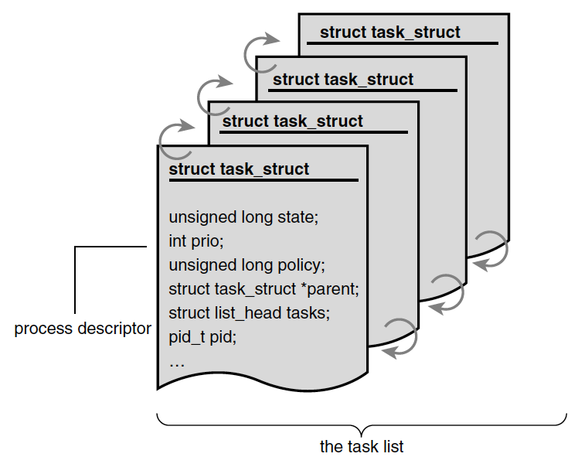
Task Lists & Process Descriptor
Process: an active program and related resources, such as processor state, memory address space.
Task Lists: A list of process descriptors in a circular doubly linked lists.
Process Descriptor (task_struct): Contains all information about a process.
Process ID (pid): A unique process identification value
In Linux, XXX Descriptor means the data structure for maintaining information for XXX.
Process Control Block (A general name) Process Descriptor (In Linux, called task_struct)
Ref: Linux Kernel Development, 3rd Edition, Robert Love
Notes:
This is the agenda.
I will first give a brief self-introduction including awards, cooperation experiences, and publication.
After that, I will give a deep dive into my research – the next-generation computing system, and present my future plan.
I will then talk about the reason for applying your department, as well as my course plan in the end of presentation.

Slide 4
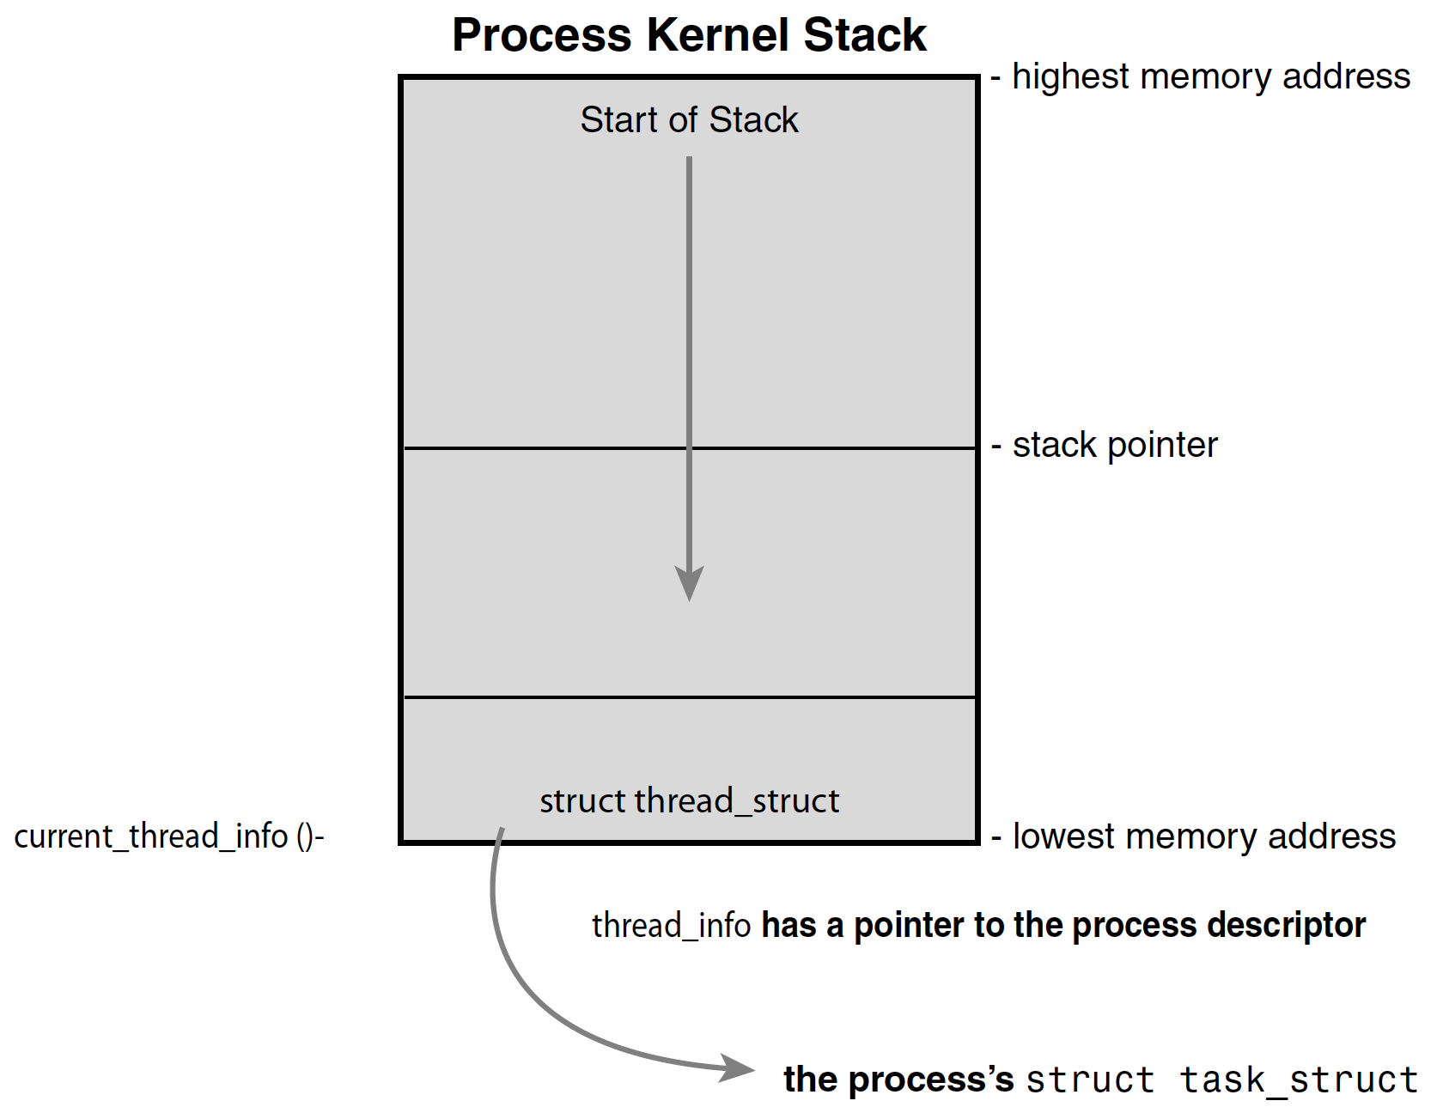
How Kernel accesses a Process Descriptor
Kernel Stack: Linux kernel uses this per-thread memory area to store intermediate information (e.g., return addresses, kernel function calls) and metadata block (thread_info) that the kernel uses to manage the thread.
A thread_info is stored at the bottom of the kernel stack. (Easier to Access)
Size of kernel stack: static 2 ~ 3 pages (4KB)
Dereferences the task member of thread_info to get the pointer of the task_struct.
Ref: Linux Kernel Development, 3rd Edition, Robert Love
Notes:
This is the agenda.
I will first give a brief self-introduction including awards, cooperation experiences, and publication.
After that, I will give a deep dive into my research – the next-generation computing system, and present my future plan.
I will then talk about the reason for applying your department, as well as my course plan in the end of presentation.

Slide 5
Process State
The state field of the process descriptor describes the current condition of the process (In one of the five states)
Task_Running: Runnable, either running or on a run-queue. (The only state for a process executing in user-space)
Task_Interruptible: Sleeping (i.e., blocked), waiting for some condition.
Task_Uniterruptible: Sleeping, does not wake up even receives a signal.
__Task_Stopped: Execution has stopped. (SIGCONT to resume)
__Task_Traced: Processes traced by a Debugger.
(Kernel thread will manage it periodically. Fork Process.)
Ref: Linux Kernel Development, 3rd Edition, Robert Love
Notes:
This is the agenda.
I will first give a brief self-introduction including awards, cooperation experiences, and publication.
After that, I will give a deep dive into my research – the next-generation computing system, and present my future plan.
I will then talk about the reason for applying your department, as well as my course plan in the end of presentation.

Slide 6
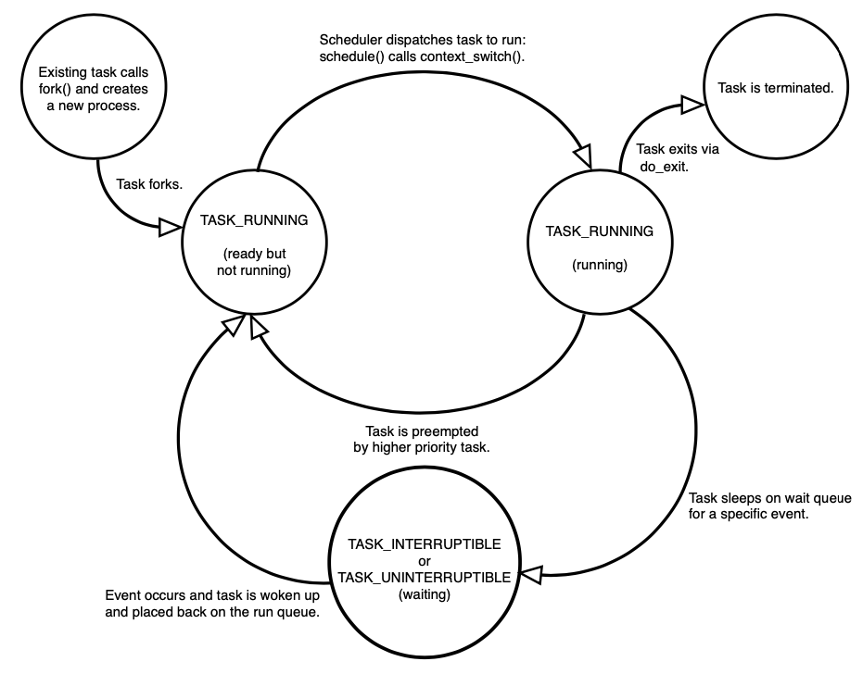
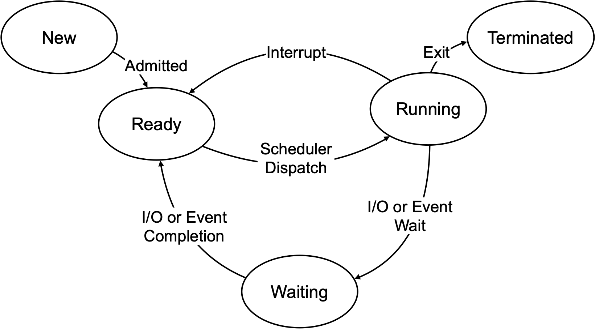
Process State Diagram
The life cycle of a process.
Concept
Ref: Linux Kernel Development, 3rd Edition, Robert Love
Linux Kernel
Notes:
This is the agenda.
I will first give a brief self-introduction including awards, cooperation experiences, and publication.
After that, I will give a deep dive into my research – the next-generation computing system, and present my future plan.
I will then talk about the reason for applying your department, as well as my course plan in the end of presentation.

Slide 7
The Process Family Tree
The first process: All processes are descendants of the init process (PID 1)
How to accesses one’s parent or children: Use the parent or the children pointer provided by the process descriptor (i.e., task_struct), respectively.
How to access other processes: By traversing through the task_list.

Slide 8
Process Creation
Process Creation = fork() + exec()
fork(): Create a child by copying its parent. (Reason: efficient and simple!) (Notice: PID, Page Table, Page Frames and some signals are different)
exec(): Loads a new executable into the address space (i.e., memory) and runs it.
Copy-on-Write (CoW)
Challenge: Naively copying all resources from a parent process is time consuming.
How CoW works: Delay and prevent copying data until the data is written. (i.e., resources are shared read-only)
Paging: Evenly partition the land
Virtual Address: Mail Address Physical Address: Latitude and Longitude
CPU
CPU walks the page table to get a location
of a page frame before accesses the page frame.
1
2
Read Only
Read Only
New
Page Frame
Page Frame (e.g, heap)
Page Frame
(e.g., heap)
Write Data
P1’s Page Table
P2’s Page Table
VA -> PA
Write to a Page
VA -> PA
VA -> PA
Assume only one-level (4-level Actually)
Fork() + Write → Copy Page Table
Copy-on-Write
4KB
Physical Address (e.g., DRAM)
Ref: https://blog.csdn.net/qq_34556414/article/details/108399543
Notes:
Depends on the Operating System, hardware architecture and libc. But yes in case of recent Linux with MMU the fork(2) will work with copy-on-write. It will only (allocate and) copy a few system structures and the page table, but the heap pages actually point to the ones of the parent until written.
More control over this can be exercised with the clone(2) call. And vfork(2) beeing a special variant which does not expect the pages to be used. This is typically used before exec().
As for the allocation: the malloc() has meta information over requested memory blocks (address and size) and the C variable is a pointer (both in process memory heap and stacks). Those two look the same for the child (same values because same underlying memory page seen in the address space of both processes). So from a C program point of view the array is already allocated and the variable initialized when the process comes into existence. The underlying memory pages are however pointing to the original physical ones of the parent process, so no extra memory pages are needed until they are modified.
If the child allocates a new array it depends if it fits into the already existing heap pages or if the brk of the process needs to be increased. In both cases only the modified pages get copied and the new pages get allocated only for the child.
This also means that the physical memory might run out after malloc(). (Which is bad as the program cannot check the error return code of "a operation in a random code line"). Some operating systems will not allow this form of overcommit: So if you fork a process it will not allocate the pages, but it requires them to be available at that moment (kind of reserves them) just in case. In Linux this is configurable and called overcommit-accounting.

Slide 9
Recap: Process Creation
Process Creation = fork() + exec()
fork(): Create a child by copying its parent. (Reason: efficient and simple!) (Notice: PID, Page Table, Page Frames and some signals are different)
exec(): Loads a new executable into the address space (i.e., memory) and runs it.
Copy-on-Write (CoW)
Challenge: Naively copying all resources from a parent process is time consuming.
How CoW works: Delay and prevent copying data until the data is written. (i.e., resources are shared read-only)
Paging: Evenly partition the land
Virtual Address: Mail Address Physical Address: Latitude and Longitude
CPU
CPU walks the page table to get a location
of a page frame before accesses the page frame.
1
2
Read Only
Read Only
New
Page Frame
Page Frame (e.g, heap)
Page Frame
(e.g., heap)
Write Data
P1’s Page Table
P2’s Page Table
VA -> PA
Write to a Page
VA -> PA
VA -> PA
Assume only one-level (4-level Actually)
Fork() + Write → Copy Page Table
Copy-on-Write
4KB
Physical Address (e.g., DRAM)
Ref: https://blog.csdn.net/qq_34556414/article/details/108399543
Notes:
Depends on the Operating System, hardware architecture and libc. But yes in case of recent Linux with MMU the fork(2) will work with copy-on-write. It will only (allocate and) copy a few system structures and the page table, but the heap pages actually point to the ones of the parent until written.
More control over this can be exercised with the clone(2) call. And vfork(2) beeing a special variant which does not expect the pages to be used. This is typically used before exec().
As for the allocation: the malloc() has meta information over requested memory blocks (address and size) and the C variable is a pointer (both in process memory heap and stacks). Those two look the same for the child (same values because same underlying memory page seen in the address space of both processes). So from a C program point of view the array is already allocated and the variable initialized when the process comes into existence. The underlying memory pages are however pointing to the original physical ones of the parent process, so no extra memory pages are needed until they are modified.
If the child allocates a new array it depends if it fits into the already existing heap pages or if the brk of the process needs to be increased. In both cases only the modified pages get copied and the new pages get allocated only for the child.
This also means that the physical memory might run out after malloc(). (Which is bad as the program cannot check the error return code of "a operation in a random code line"). Some operating systems will not allow this form of overcommit: So if you fork a process it will not allocate the pages, but it requires them to be available at that moment (kind of reserves them) just in case. In Linux this is configurable and called overcommit-accounting.

Slide 10
Process Creation (Count.)
Process Creation = fork() + exec()
fork(): Create a child by copying its parent. (Notice: PID, Page Table, and some signals are different)
exec(): Loads a new executable into the address space (i.e., memory) and runs it.
Copy-on-Write (CoW)
Challenge: Naively copying all resources from a parent process is time consuming.
How CoW works: Delay and prevent copying data until the data is written. (i.e., resources are shared read-only)
Linux Implementation: copy_process()
Allocate a new kernel stack (e.g., thread_info) and process descriptor (i.e., task_struct)
Copy (e.g., program counter, states) or set (e.g., PID) fields in the process descriptor
Set the state field to TASK_UNINTERRUPTABLE (Reason: initialization is non-interruptible)
Duplicate parent’s page table
Duplicate (Process) or Share (Thread): Open files, filesystem information, signal handlers, process address space (Notice: Does not share Stack), and namespace.
Notes:
Depends on the Operating System, hardware architecture and libc. But yes in case of recent Linux with MMU the fork(2) will work with copy-on-write. It will only (allocate and) copy a few system structures and the page table, but the heap pages actually point to the ones of the parent until written.
More control over this can be exercised with the clone(2) call. And vfork(2) beeing a special variant which does not expect the pages to be used. This is typically used before exec().
As for the allocation: the malloc() has meta information over requested memory blocks (address and size) and the C variable is a pointer (both in process memory heap and stacks). Those two look the same for the child (same values because same underlying memory page seen in the address space of both processes). So from a C program point of view the array is already allocated and the variable initialized when the process comes into existence. The underlying memory pages are however pointing to the original physical ones of the parent process, so no extra memory pages are needed until they are modified.
If the child allocates a new array it depends if it fits into the already existing heap pages or if the brk of the process needs to be increased. In both cases only the modified pages get copied and the new pages get allocated only for the child.
This also means that the physical memory might run out after malloc(). (Which is bad as the program cannot check the error return code of "a operation in a random code line"). Some operating systems will not allow this form of overcommit: So if you fork a process it will not allocate the pages, but it requires them to be available at that moment (kind of reserves them) just in case. In Linux this is configurable and called overcommit-accounting.

Slide 11
Process vs Thread
Thread (Lightweight Process): Executes within the same program in a shared memory address space (also share open files and page tables).
Linux implements all threads as standard processes (Have their own task_struct).
Threads have their own: (1) Program Counter, (2) Registers, (3) Stack, (4) State
Linux does not provide any special scheduling or data structures to represent threads.
Creating Threads: clone() is identical to fork(), except that the address space, file system resources, file descriptors, and signal handlers are shared.
clone (CLONE_VM | CLONE_FS | CLONE_FILES | CLONE_SIGHAND, 0)
Kernel Threads: Run kernel tasks in the background.
Like normal processes, schedulable and preemptable
But, in contrast to normal processes, kernel threads do not have an address space.
Operate only in kernel-space and do not context switch to user-space.

Slide 12
Process Termination
Termination occurs when the process or C compiler calls exit().
Sets the PF_EXITING flag in the flags member of the task_struct.
Call exit_mm() to release the mm_struct (address space) held by this process.
Call exit_sem() dequeued from an IPC semaphore waiting queue.
Call exit_files() and exit_fs() to decrement the usage count of objects related to file descriptors and filesystem data, respectively.
Call exit_notify() to send signals to the task’s parent, reparents any of the task’s children to another thread in their thread group or the init process.
Call schedule() to switch to a new process.
After the parent retrieves the information, the process’s kernel stack (including task_struct and thread_info) will be deallocated.
Notes:
Linux supports three type of IPC message queues, semaphores and shared memory

Slide 13
Process Scheduling
Notes:
Good Morning, My name is Chun-Feng Wu. In this presentation, I will briefly introduce myself and share some key idea of my researches.
Intensive data movement is one of the critical issue when Von-Neumann machines enter the big data era.
To deal with this issue, my research is to enable a fast, large and device-friendly next-generation computing system.

Slide 14
Multitasking Systems
Single Processor: Time sharing and it is virtual parallelism. (Multiprogramming)
Multiple Processors: Run on different processors concurrently.
Criteria for Schedulers: Fairness, Response Time (Interactive), Throughput
Cooperative: Processes voluntarily yield CPU.
Preemptive: Involuntarily suspend (context switch) a running process. (Linux)
Timeslice: The time a process runs before it is preempted.
Prevent some processes monopolizing processors.
How to decide the timeslice ? Which process shall be run next?
Schedule & Run
Preempt & Run Others
Timeslice
Overall Process Run Time
Notes:
In preemptive multitasking, the scheduler decides
when a process is to cease running and a new process is to begin running.The

Slide 15
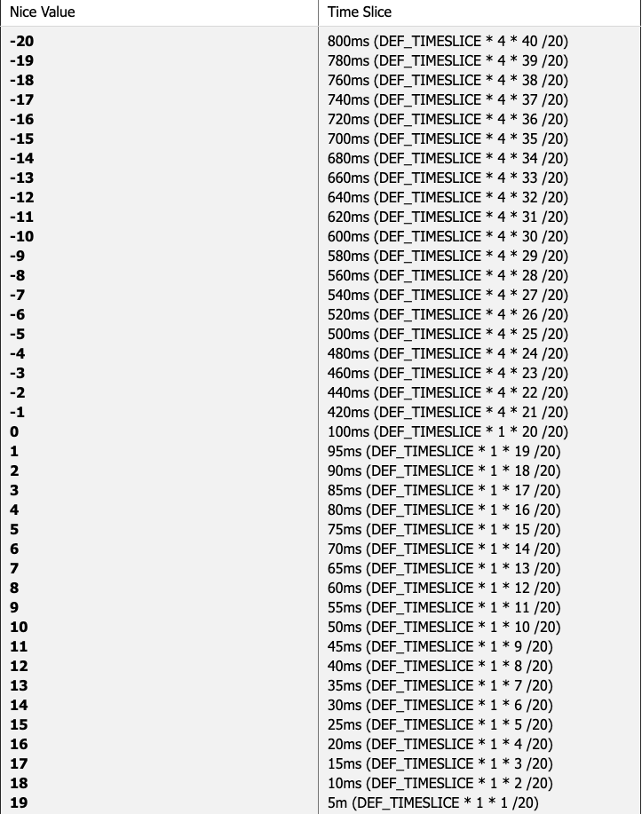
Considerations for Designing Policies
Process Priority:
nice value: larger value represents being nicer to others, so lower priority (normal processes).
real-time value: all real-time processes have higher priority than normal processes.
Timeslice (static mapping):
Longer timeslice → Better Resource Utilization.
Challenge 1: Triggers context switch frequently if all processes are low priority.
Ex: Switch every 5ms if nice value is 19
Challenge 2: Timeslice difference is huge for processes with higher nice value (lower priority)
Ex: T₋₂₀=T₋₁₉+20, T₁₉ = T₁₈/2 (Resource unbalance)
CFS can solve these challenges, but O(1) cannot.
Linux 2.6 Priority vs Timeslice
Ref: https://blog.xuite.net/csiewap/cc/15735104-Linux+2.4%2F2.6+%E6%A0%B8%E5%BF%83%E6%8E%92%E7%A8%8B%E6%A9%9F%E5%88%B6%E5%89%96%E6%9E%90, 2007
Notes:
response time vs throughput
Fairness Challenge: Preempt a process by considering static values, such as timeslice and priority .

Slide 16
Considerations for Designing Policies (Count.)
Process Priority
Timeslice
Process Characteristics:
I/O-Bound: Spends much of time submitting and waiting on I/O requests.
I/O: keyboard, network, storage
Example: Graphical User Interface (GUI)
Policy: Run more frequently and interactive, shorter timeslice
Processor-Bound: Spends much of time executing code.
Example: ssh-keygen, MATLAB
Policy: Run less frequently, longer timeslice
Maintenance Overhead:
How to find the next process: (1) Queue (2) Tree (3) Bit-map
Global runqueue (Lock) or Per-processor runqueue (Processor’s utilization)
Notes:
I/O-Bound vs Processor-Bound
How to judge a process is I/O-bound or Processor-Bound?

Slide 17
Linux Process Scheduler
O(N) Before Kernel 2.4 (Simple):
All processors share a global runqueue. (Sort processes by their priority)
Bad: Shall lock the runqueue when a process runs out of its timeslice.
Bad: Processes shall be inserted to an expired queue in order. (Scale poorly when there are tons of processes)
O(1) Kernel 2.5 (Fast):
Check active array (bitmap) to get the target priority value (leftmost).
Use the priority value to get (dequeue) the next process (FIFO) in the active array.
Recalculate priority and enqueue to the expired bitarray.
When no bit is set in active bitarray, switch active and expired bitarrays.
Bad: Low interactive performance (Low priority processes)
Find the leftmost bit with bit set. O(1)
Queue 0
Null
32 Bits
Queue 1
Task 1
Task 3
…
140-bits bitmap of priority array (Active bitarray & Expired bitarray)
Queue 139
Task 10
Task 4
Task 2
Active Array
Ref: Jserv’s Hackmd (https://hackmd.io/@sysprog/linux-scheduler) , 2022

Slide 18
Linux Process Scheduler
Example
O(N) Before Kernel 2.4
O(1) Kernel 2.5
Completely Fair Scheduler (CFS) Kernel 2.6 O(log(N):
Goal: more interactive and more “Fair” than O(1).
Concept: (1) Instead of statically mapping timeslice, each process would receive 1/n of the processor’s time (fair share). (2) Schedule processes for infinitely small durations.
Two Process: P1 (Nice 0), P2 (Nice 19)
Overall CPU:
P1: 6ms*1024/(1024+15) = 5.9ms
P2: 6ms*15/(1024+15) = 0.1ms
- Initial Vruntime to 0
- P1 runs first, facing I/O after 1ms
- P2 takes over, after 0.05ms P1 finishes
P1’s vruntime += 1*1024/1024 = 1
P2’s vruntime += 0.05*1024/15 = 3
Virtual Runtime: Real system running time + Priority (Keep the virtual runtime of all running processes the same)
P1 preempts P2!
50
Allocated_CPU_Time = __sched_period() * NICE_Weight /NICE_k_Weight
(Theory) Vruntime += delta_exec * NICE_0_Weight/NICE_Weight
__sched_period: Period to enter scheduler (e.g., 6ms or 0.75ms, a constant)
delta_exec: execution time for a process (or called wall time)
NICE_Weight: Weight for the corresponding nice value (e.g., 0 → 1024)
NICE_k_Weight: Overall weights of the all k running processes
30
80
(Practical) Vruntime += (delta_exec * NICE_0_Weight * 2³²/NICE_Weight) >> 32
NIL
5
70
90
NIL
NIL
NIL
NIL
NIL
NIL
Small
Virtual Runtime (Index)
Large
Ref: https://developer.ibm.com/tutorials/l-completely-fair-scheduler/ Ref2: https://codingnote.cc/zh-tw/p/78397/
Ref3: https://mechpen.github.io/posts/2020-04-27-cfs-group/index.html
Most Need of CPU
Least Need of CPU
Notes:
0.75ms when there is more than 8 processes.
Practical is for systems without FPU.

Slide 19
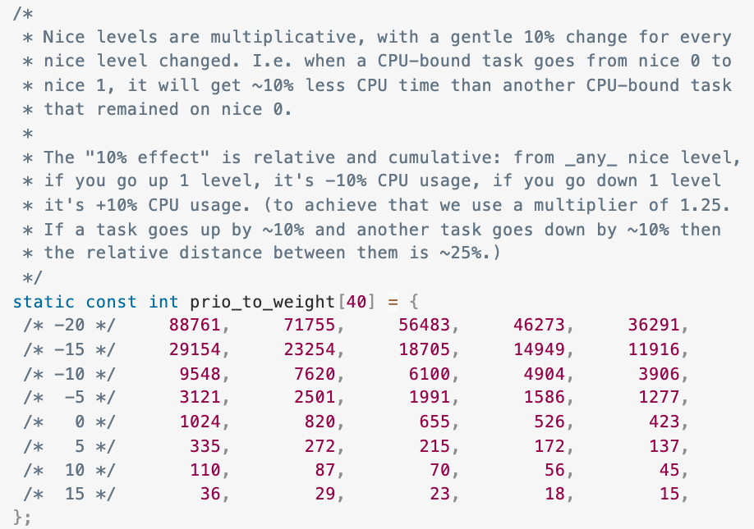
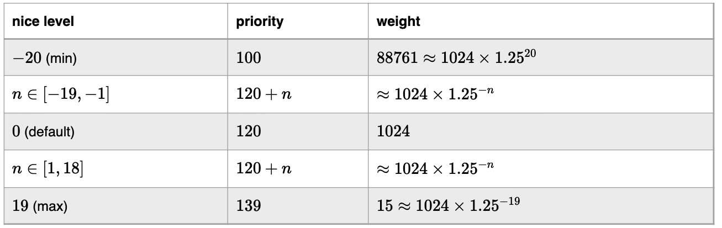
Linux Process Scheduler (Count.)
O(N) Before Kernel 2.4
O(1) Kernel 2.5
Completely Fair Scheduler (CFS) Kernel 2.6:
Goal: Be more interactive and “Fair” than O(1).
How to decide the weight?
Ans: Follow the 10% effect
Vruntime = delta_exec * NICE_Weight/NICE_k_Weight
Virtual Runtime
Ref1: https://developer.ibm.com/tutorials/l-completely-fair-scheduler/
Ref2: https://codingnote.cc/zh-tw/p/78397/
Ref3: https://mechpen.github.io/posts/2020-04-27-cfs-group/index.html Ref4: https://hackmd.io/@RinHizakura/B18MhT00t
Linux Kernel 4.4
(18-15)/(18+15) = ~10%

Slide 20
Realtime Scheduling Policies
Soft Realtime: kernel tries to schedule applications within timing deadlines. (Linux only provides soft realtime)
Hard Realtime: systems are guaranteed to meet any scheduling requirements within certain limits.
Linux Realtime Scheduling Policies:
Priority Range: 0~99 (Realtime Processes), 100~139 (Normal Processes)
FIFO (SCHED_FIFO): tasks continue to run until it blocks or explicitly yields the processor. FIFO tasks have no timeslice and can run indefinitely.
Only a high priority FIFO or RR Tasks can preempt.
Round Robin (SCHED_RR): FIFO with timeslice.
A lower-priority process can never preempt a SCHED_RR task, even if its timeslice is exhausted.

Slide 21
Process Context Switch
Process Context: Contents of user address space (e.g., page table), hardware registers (e.g., PC) and kernel data structures that relate to the process.
You can also think like this, context is very similar to an ”environment” to run something.
Process Context Switch: Switching from one runnable process to another.
switch_mm(): Switch the virtual memory mapping (e.g., page table, TLB)
switch_to(): Switch the process state (e.g., processor register, architecture-specific state)
Flush Branch Predictor Buffer
Load New Page Table (CR3)
Flush TLB
Load New CR4 (Page Size Extension)
Load LDT (Not used for user processes)
Abstract of switch_mm() on Linux 4.4
Ref1: https://www.beyonddiscovery.org/unix-operating-system/63-the-context-of-a-process.html
Ref2: https://www.maizure.org/projects/evolution_x86_context_switch_linux/
Notes:
It's important to note that while descriptor tables are a part of x86 architecture and legacy operating system design, modern operating systems, including Linux, have largely shifted away from relying on descriptor tables for memory protection and process isolation. Instead, they use memory paging (as discussed earlier) for finer-grained and more flexible memory management and protection. Descriptor tables are still used for some low-level CPU-specific tasks, but they are mostly managed by the kernel and are not directly exposed to user-level processes in contemporary operating systems.

Slide 22
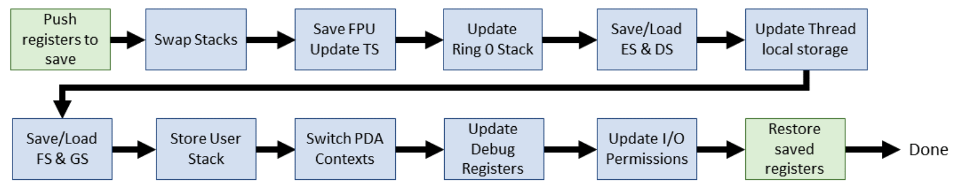
Process Context Switch (Count.)
Process Context Switching: Switching from one runnable process to another.
switch_mm(): Switch the virtual memory mapping (e.g., page table, TLB, Cache)
switch_to(): Switch the process state (e.g., processor register, architecture-specific state)
Store General Purpose Register (Hardware Context)
Data Segment and Programmer Defined Segment
TS: Task Switching Flag (a flag in CR0)
ES: Programmer Defined Segment DS: Data Segment FS/GS: Access thread local storage (TLS)
Pointer to TLS (e.g., code run in thread, local parameter)
per_Processor_Data_Area (PDA), IRQ, mmu_state…
Abstract of Switch_to on Linux 2.6.0
Ref1: https://www.maizure.org/projects/evolution_x86_context_switch_linux/
Notes:
https://stackoverflow.com/questions/2754295/what-segments-does-c-compiled-program-use
https://stackoverflow.com/questions/14500495/thread-local-and-context-switch
Thread Local Storage is just that - storage per thread. Each thread has it's own private data structure. That thread, whichever processor it runs on, is the same thread. The OS doesn't schedule work WITHIN threads, it schedules which of the threads runs.
The thread local storage is acomplished by having some sort of indirection, which is changed along with the thread itself. There are several ways to do this, for example, the OS may have a particular page at a particular offset from the start of virtual memory in the process, and when a thread is scheduled, the page-table is updated to match the thread.
In x86 processors, FS or GS is typically used for "per-thread" data, so the OS will switch the FS register [or the content of the base-address of the register in case of 64-bit processors]. When reading the TLS, the compiler will use the FS or GS segment register to prefix the memory read/write operations, and thus you always get "your private data", not some other threads.
https://stackoverflow.com/questions/35692188/what-is-thread-local-storage-why-we-need-it
Static and global data are shared across all the threads. If you modified a global/static variable it is visible to all the threads. Unlike global/shared variable if you create a variable in TLS, every thread has its own copy of the variable, i.e. changes to the variable is local to the thread. Unlike global variable where an access is made through ds segment, the TLS variable are accessed using (gs/fs) segment. A good way to learn about it is to look at the disassembly generated by the compiler. PDA: https://blog.csdn.net/bingqingsuimeng/article/details/7856702

Slide 23
CPU Mode Switch vs Process Context Switch
While facing exceptions or interrupts, CPU switches from user mode to kernel mode to run kernel code.
CPU shall also do context switching but not process-level context switching
Before switching to kernel mode, CPU shall save user mode context
User mode context: program counter, user-mode-specific state (e.g., user-space stack pointer register (ESP or RSP), floating point register, user-space instruction pointer)
Note: when we say save context, we generally mean to write back all those registers to the corresponding process descriptor (i.e., task_struct) in main memory.

Slide 24
System Call

Slide 25
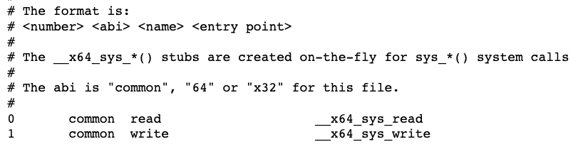
What is System Call
Goal: let user-space processes interact with the operating system, the kernel provides a set of interfaces, called system calls.
How to run: System calls are accessed via function calls defined in the C library.
System Call Numbers: Each system call has a unique number. (Cannot change all corresponding numbers during runtime.)
sys_call_table: The kernel keeps a list of all system calls in the system call table.
Call to printf()
Printf() in the C library write() in the C library
Write() system call
Monitor is a character device!
(Backed by a file)
Application
C Library
Kernel
Linux 4.17.4 → /arch/x86/entry/syscalls/syscall_64.tbl
Notes:
It is not possible for user-space applications to execute kernel code directly

Slide 26

System Call Handler
How to run system call:
User-space applications must somehow signal to the kernel →system call handler
The CPU switches from user mode to kernel mode (Not Context Switch!!)
Execute code corresponding to the system call
Details for System call handler
How to signal → Software interrupt (i.e., an exception)
Run INT $0x80 → Interrupt Instruction, number 128 (runs the system call handler)
INT $0x80
eax ← Sys_Call_Num
Sys_Call_Table[ Sys_Call_Num]
User Mode
Process A
Process A
Kernel Mode
System Call Handler
Check Sys _Call_Table
Run System Call
Notes:
It is not possible for user-space applications to execute kernel code directly
Before causing the trap into the kernel, user-space sticks in eax the number corresponding to the desired system call.
The system call handler then reads the value from eax. Other architectures do something similar.
A faster way: Sysenter

Slide 27
How to Implement a System Call
Adding (Registering) a new system call to Linux is easy and do not need to be concerned with the behavior of the system call handler
Brief Procedures (Details: See References):
Write a new system call (e.g., sys_hello.c)
Create a Makefile
Add the new system call into the system call table
Parameters: System_call_number, arch(e.g., 64), system_call_name, program_of_system_call
Add the new system call to the header file (include/linux/syscalls.h)
Compile/Install/Update Kernel
User Space
Kernel Space
call read()
read() wrapper
system_call()
sys_read()
Application
C Library
System Call Handler
System call
[1] https://medium.com/anubhav-shrimal/adding-a-hello-world-system-call-to-linux-kernel-dad32875872.
[2] https://tssurya.wordpress.com/2014/08/19/adding-a-hello-world-system-call-to-linux-kernel-3-16-0/
[3] https://dev.to/jasper/adding-a-system-call-to-the-linux-kernel-5-8-1-in-ubuntu-20-04-lts-2ga8
Notes:
It is not possible for user-space applications to execute kernel code directly How system call runs (Detail) https://0xax.gitbooks.io/linux-insides/content/SysCall/linux-syscall-2.html

Slide 28
Interrupts

Slide 29
Handling Hardware Events
How CPUs work with slower hardware devices
Polling: Periodically, the kernel checks hardware status and responds accordingly.
Interrupt: Let the hardware to signal to the kernel.
What causes interrupts:
Interrupt (Asynchronous, Hardware Interrupts): Hardware devices physically produce electronic signals, which are directed into input pins on an interrupt controller.
Motherboard
Local APIC
Local APIC
CPU
CPU
Chipset
DRAM
Northbridge (Memory Controller Hub)
GPU
Southbridge (I/O Controller Hub)
Keyboard
Interrupt Controller (I/O APIC)
HDD
PCIE SSD
Note: After 2019, all northbridge functions
had been integrated into CPU!!
Ref1: https://zhuanlan.zhihu.com/p/313725721
Ref2: https://en.wikipedia.org/wiki/Northbridge_(computing)

Slide 30
Handling Hardware Events (Count.)
How CPUs work with slower hardware devices
Polling: Periodically, the kernel checks hardware status and responds accordingly.
Interrupt: Let the hardware to signal to the kernel.
What causes interrupts:
Interrupt (Asynchronous, Hardware Interrupts): Hardware devices physically produce electronic signals, which are directed into input pins on an interrupt controller (e.g., keyboard, disk).
Exceptions (Synchronous, Software Interrupts): Exceptions are produced by the processor while executing instructions either in response to a programming error (e.g., divide by zero) or abnormal condition (e.g., call a system call or a page fault).

Slide 31
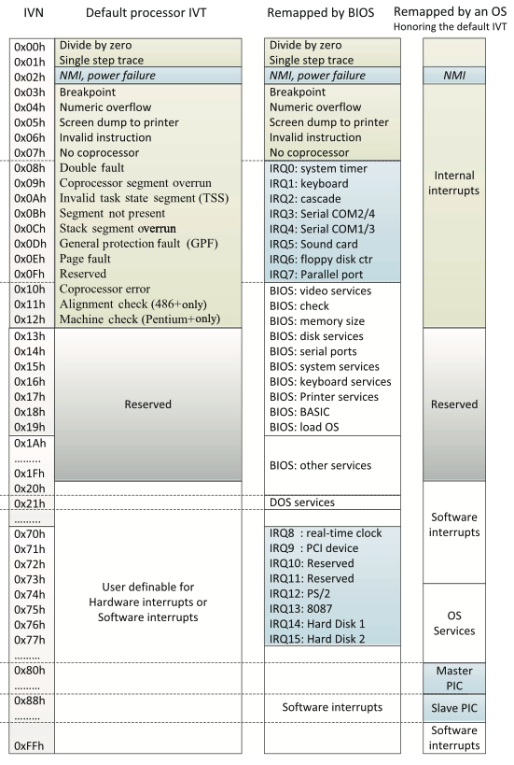
Interrupt Request (IRQ)
Interrupt Vector Number (IVN)
Different devices can be associated with different interrupts by means of a unique interrupt value (max: 256) associated with each interrupt (Just like system call!)
Interrupt Request (IRQ):
Specific interrupt is associated with a specific device,
and the kernel knows this. (Assigned during boot)
IRQ 0 → timer interrupt
IRQ 1 → keyboard interrupt
Dynamically Allocate IRQ # → PCI devices
X86 Interrupt Vector Table
(Arch Dependent)
Ref1: Fan, Xiaocong. Real-time embedded systems: design principles and engineering practices. Newnes, 2015.

Slide 32
How an Interrupt Works
How an interrupt works:
Hardware devices send out an interrupt signal.
The CPU stops current execution.
The interrupt controller sends INT # to the CPU.
CPU accesses the Interrupt Vector Table by INT # * 4
The CPU runs the interrupt service routine to handle the interrupt.
ISR=Interrupt Service Routine
Motherboard
INT 0x81
Local APIC
CPU
CS‘:IP’
0x81 * 4 = 0x204
Code of ISR
0x0
0x4
0x204
CS‘:IP’
ISR 0
Vec
ISR 81
Vec
ISR 255
Vec
ISR 81
Memory
ISR 1
Vec
…
…
4B (CS:IP)
Timer
Southbridge (I/O Controller Hub)
Interrupt
IRQ0
Keyboard
Interrupt Controller
IRQ1
IRQ 1 → INT 0x81 (Translates to IVN)
…
IRQ2
IRQ8
Ref1: Fan, Xiaocong. Real-time embedded systems: design principles and engineering practices. Newnes, 2015.
Notes:
Actually, there is no specific name for the table inside interrupt controller

Slide 33
Interrupt Handler
Interrupt Service Routine (ISR) or Interrupt Handler: The function the kernel runs in response to a specific interrupt.
It is part of a device driver (the kernel code manages the device)
Challenge: ISR is non-blockable (Cannot Sleep). The handler shall run quickly, to resume execution of the interrupted code as soon as possible.
Split the ISR into two parts (Top Halves + Bottom Halves):
Top Halves: Run immediately upon receipt of the interrupt and performs only the work that is time-critical.
Bottom Halves: Work that can be performed later is deferred until the bottom half.
Example:
A network card received a Packet.
Top Halves move the packet from the buffer in the network card to host memory.
Bottom Halves will process the packet later.

